Slide 1
Best Practices in Section Management & Public Information
Kevin O’Kula
ANS Savannah River Section
Program Chair and Past Chair
Presented to:
ANS Local Section Committee Meeting
ANS Winter Meeting & Expo,
Washington, D.C.
November 8, 2015

Slide 2
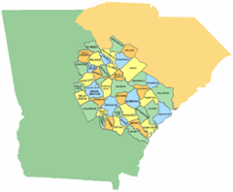
SR Section Domain
The American Nuclear Society – Savannah River Section covers 46 counties in Georgia and South Carolina
South Carolina
Georgia
Core Purpose
The core purpose of the ANS Savannah River Section is to promote the awareness and understanding of the application of nuclear science and technology locally (in the Central Savannah River Area), nationally and globally.
Membership comes from:
Government Nuclear (Savannah River Site – DOE, SRNS, SRR, CB&I AREVA MOX Services, CBI, Parsons, et al.)
Commercial Nuclear (Southern Company’s Georgia Power)
Nuclear Medicine (GRU)
Universities/Colleges/ (USC-Aiken, Augusta University, Aiken Tech, Augusta Tech
Other Nuclear Consulting Firms, Interests (Retirees, etc.)

Slide 3
Public Information
Have established a core group of nuclear professionals to conduct workshops (~15 “events” per year)
Pair Late-to-Mid-Career Leads with early-career Professionals
Both student and teacher levels
Implement new ways of delivering the nuclear science and technology message
Isotope Discovery Kit
Southeastern Summer Nuclear Institute
Create cross-generational appeal
Nuclear Trivia
Reach out to the public, local & local professionals members in all communications
Monthly meetings, Newsletter, website, local newspaper, and social media
Engage broader ANS members through topical conference sponsorships
Notes:
The Kit was developed by SRS nuclear engineer and ANS SR member Bill Wabbersen, and is available through the ANS Outreach website, http://www.nuclearconnect.org/in-the-classroom/for-teachers/isotope-discovery-kit . It is regularly used by our Section members and other ANS sections. The public outreach arm of ANS-SR continues to be very active, especially in partnership with the Citizens for Nuclear Technology Awareness (CNTA). This year, in addition to our many school career day and classroom presentations on STEM and nuclear technology, we made a special effort to reach out to instruct even more teachers. The culminating event was the inaugural Southeastern Summer Nuclear Institute (SSNI), where 21 middle and high school teachers from Georgia and South Carolina received training on STEM (with a focus in nuclear) and how they can use hands-on activities in their classrooms to illustrate important technical concepts and scientific principles.

Slide 4
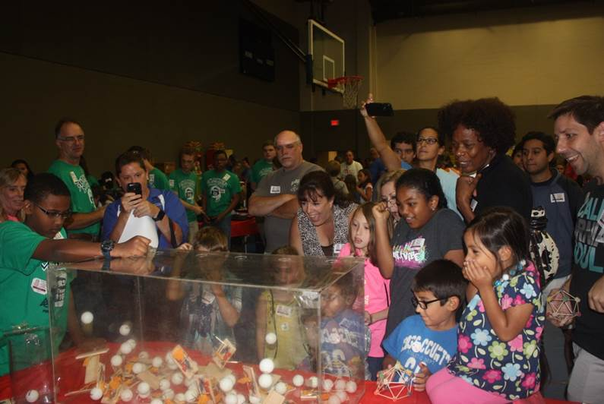
Public Information /Outreach
SEED – October 2015
Have established a core group of nuclear professionals to conduct workshops (~20 “events” per year)
Pair late-to-mid-career leads with early-career professionals
Both student and teacher levels
Implement new ways of delivering the nuclear science and technology message
Isotope Discovery Kit
Nuclear Trivia
Southeastern Summer Nuclear Institute
Notes:
The Kit was developed by SRS nuclear engineer and ANS SR member Bill Wabbersen, and is available through the ANS Outreach website, http://www.nuclearconnect.org/in-the-classroom/for-teachers/isotope-discovery-kit . It is regularly used by our Section members and other ANS sections. The public outreach arm of ANS-SR continues to be very active, especially in partnership with the Citizens for Nuclear Technology Awareness (CNTA). This year, in addition to our many school career day and classroom presentations on STEM and nuclear technology, we made a special effort to reach out to instruct even more teachers. The culminating event was the inaugural Southeastern Summer Nuclear Institute (SSNI), where 21 middle and high school teachers from Georgia and South Carolina received training on STEM (with a focus in nuclear) and how they can use hands-on activities in their classrooms to illustrate important technical concepts and scientific principles.

Slide 5
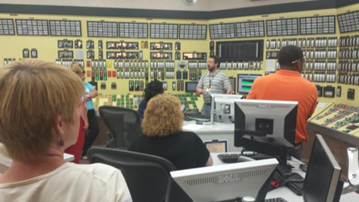
Southeastern Summer Nuclear Institute
Inaugural SSNI July 2015 at Plant Vogtle, USC-Aiken, and other sites
Twenty-one middle and high school teachers from Georgia and South Carolina
Promotes nuclear education and workforce development in the southeast – 3 days
Partnered with Citizens for Nuclear Technology Awareness (CNTA)
Directed to teachers who have an interest in learning or sharing more knowledge about nuclear technology applications
Led by Mel Buckner (SRNL retiree) and Mike McCracken (Southern Company)
Hands-on and classroom activities, also Vogtle Simulator time (below)

Slide 6
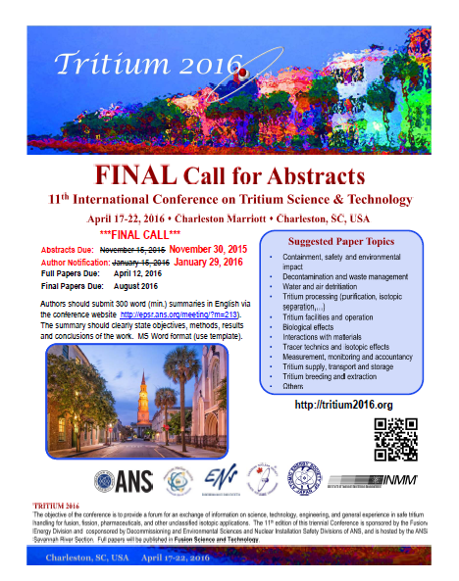
Topical Conference Sponsorship
Notes:
The Kit was developed by SRS nuclear engineer and ANS SR member Bill Wabbersen, and is available through the ANS Outreach website, http://www.nuclearconnect.org/in-the-classroom/for-teachers/isotope-discovery-kit . It is regularly used by our Section members and other ANS sections. The public outreach arm of ANS-SR continues to be very active, especially in partnership with the Citizens for Nuclear Technology Awareness (CNTA). This year, in addition to our many school career day and classroom presentations on STEM and nuclear technology, we made a special effort to reach out to instruct even more teachers. The culminating event was the inaugural Southeastern Summer Nuclear Institute (SSNI), where 21 middle and high school teachers from Georgia and South Carolina received training on STEM (with a focus in nuclear) and how they can use hands-on activities in their classrooms to illustrate important technical concepts and scientific principles.

Slide 7
Section Management
Simplifying and Enhancing Efficiency:
Implemented Savannah River Section spreadsheet suggestion
Simplifies and makes transparent section activity recordkeeping
Transitioning Leadership:
Officers and committee chairs began turnover information to describe their function and responsibilities on how they perform and how they accomplish these tasks
Facilitates new leadership and quickly bring volunteers up-to-speed
Reformatting Section Officer and Executive Committee Meetings:
While most are in-person, occasional meetings held via teleconference call
Questions?
Notes:
Section Management
ANS-SR works hard to maintain and grow the activities we undertake. We are hosting the TRITIUM 2016 Topical in April and preparation is fully underway. We have engaged a young member to shadow our
more experienced leaders in this effort. We prepare an annual newsletter, “The Neutrino” (a rough draft of the version to be issued in September is attached). We support students in scholarship aid; this year is the second year awarding the Dick Benjamin Memorial scholarship to local STEM students entering college. We are also seeking efficiency in our actions. The revised Annual

Slide 8
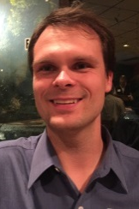
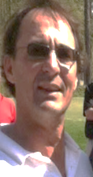
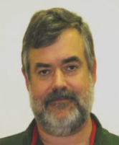
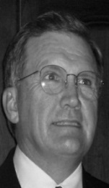
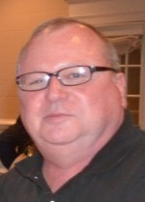
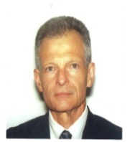
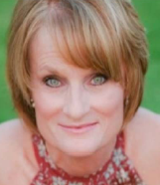
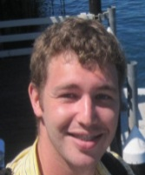
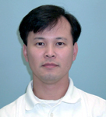
2015-2016 ANS Savannah River Section Officers, Executive Committee, & Liaisons
Chuan Fu-Wu
Chair
Karen Babkowski
Vice Chair
Dan Thomas
Treasurer
Tracy Stover
Secretary
Tim McKinsey
Arrangements
Bob Eble
Outreach
Phil Cupp
Communications
Mel Buckner
Retirees Liaison
Jeff Brault
CNTA Liaison
Mary Mewborn
NAYGN Liaison
Kevin O’Kula
Program
Diane Shelton
Administrator &
Registration
TJ Corder
(Past Chair)
Tinh Tran
Membership

Slide 9
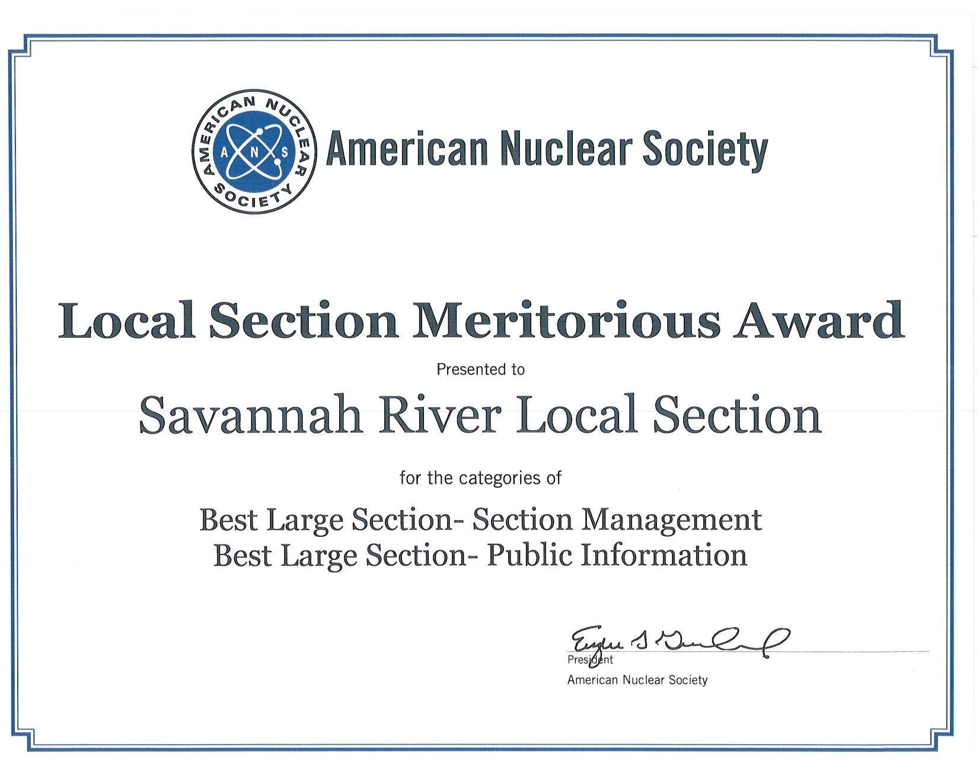
ANS SR Section Recognition at ANS Winter Meeting

