Slide 1
How to Host a Scouting Workshop

Slide 2
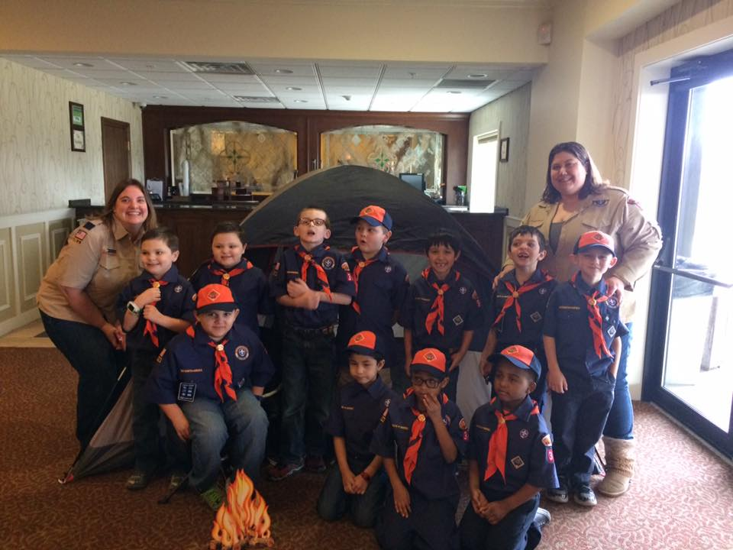
Presented by:
Tracy Coyle
Sr. Program Coordinator, ANS
Den Leader, Pack 341
Tcoyle@ans.org
Wesley R. Deason
ANS Member, Communications Committee
wdeason07@gmail.com
Notes:
This presentation was given to the Local Sections Committee to encourage sections to host scouting workshops.

Slide 3


Scout Programs
Girl Scout Get to Know Nuclear Patch (Est. by ANS in 2014)
Boy Scout Nuclear Science Merit Badge (Est. by BSA in 2005)
May be earned by:
Juniors (ages 9-10)
Cadettes (ages 11-13)
Seniors (ages 14-15)
Ambassadors (ages 16-17)
May be earned by:
Boy Scouts (ages 11 -17)
Varsity Scouts (ages 14-18)
Venturing/Sea Scouts (ages 13 -20)
Notes:
The workshop toolkits are available to ANS members in the Member Center –
Boy Scouts - http://www.ans.org/pi/resources/boyscouts/
Girl Scouts - http://www.ans.org/pi/resources/girlscouts/

Slide 4
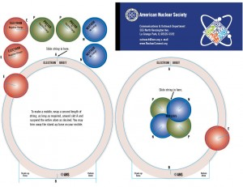
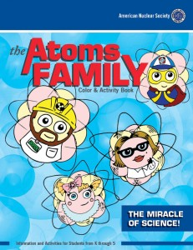

Options for younger scouts
Scout Programs
Cub Scouts and Daisies/Brownies
Ages 7 - 10
There is no patch for this age group
Topics may include:
Atoms make up everything.
We can split atoms to make energy.
Atoms can also split without our help.
Splitting atoms releases radiation, a form of energy.
We live in a world full of natural and man-made radiation.
When used responsibly, radiation provides reliable, clean energy.
We use radiation in many other helpful ways: to date fossils, in growing our food, in medicine, and in industry.

Slide 5
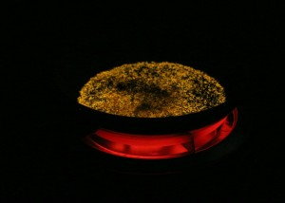

Girl Scout Requirements
Workshop Planning
Toolkit:
ans.org/pi/resources/girlscouts/
Introduction: Get to Know Nuclear PowerPoint
Must meet 5 out of 7 requirements:
Half-life
Fission vs Fusion
Careers – Girls in Science
Radiation and radioactivity are a natural part of our world
Seeing the Unseen
Modeling an Atom
Nuclear technology works
Notes:
Get to Know Nuclear
Prerequisite: Describe the basics of nuclear science.
Discuss protons, neutrons, and electrons and how atoms are structured
Discuss fission
Discuss the difference between atoms and isotopes.
Discuss isotopes, stability, and decay chains.
Discuss ionizing –vs- non-ionizing radiation
Station A – Half-life / Do one of the following:
m&mTM Half-Life Demonstration
Licorice Activity
Flip-Out (pennies)
Half–Life of Paper
Station B - Fission vs Fusion / Do one of the following:
Discuss how you use fission to make electricity. Discuss the how fusion is different.
Balloon chain reaction (critical mass)
Mouse trap reactor demonstration (long set up time, can only be done once)
Dominoes chain reaction
Fission balloons (energy release)
Nuclear fusion (marshmallows)
Station C – Careers (Girls in Science) / Do one of the following:
Discuss at least 5 careers: job descriptions, required education and training. Visit the Careers section on this site to learn more. You can also interview nuclear professionals to discuss: what they do, why they chose their career path, and how they prepared for it.
Dress up/role playing (team)
Obtain materials for outfits for at least 5 careers (e.g. lab coat, eye protection, dosimeter, Geiger counter for a radiation worker; radiation training suit, a business suit/ jacket for a manager; a backpack and notebook for a college student, etc.).
Break the scouts into sub-groups and each group gets one career. The girls work as a team to explain the job that goes with the outfit. After a few minutes have everyone come together and each group can take a turn presenting about their career.
Who run the World? Girls
If you do not have access to career items, write about famous women in nuclear history (Marie Sklodowska Curie, Harriet Brooks, Lise Meitner etc), current women in the field (Shirley Jackson, Allison M. Macfarlane, Kristine L. Svinicki – NRC, J’Tia Taylor – Survivor); or discuss why you are interested in a particular nuclear field.
Resources:
ANS Careers brochure
Station D – Radiation and radioactivity are a natural part of our world / Do one of the following:
Calculate your annual dose
Complete the ANS Radiation dose chart. An adult should walk the girls through this step-by-step to ensure they know what each item is.
Explain the concepts of time, distance, and shielding.
Detecting Radiation
Obtain Geiger counters, sources (alpha, beta, gamma), and shielding materials (paper and lead)
Place sources at different heights/lengths to demonstrate distance.
Station E – Seeing the Unseen / Do one of the following:
Build a cloud chamber
Build an electroscope (ionization chamber)
Radiation photographs
Station F – Modeling an Atom / Do one of the following:
Rutherford Boards
Modeling atoms (marshmallows)
3D Anatomy of an atom (cut-out)
Station G – Nuclear technology works / Do one of the following: (Cadets/Seniors/Ambassadors Only)
Since it is difficult to organize a plant tour on your own, scout troops are encouraged to coordinate tours with nuclear professionals through one of ANS’s local sections. To locate and contact a section in your area, please visit the ANS website. If you are working with a facility for a tour, they may have restrictions on when the girls can tour. This session can be moved to accommodate the facility. If a tour is not possible, Cadettes/Seniors/Ambassadors can complete option #4.
Visit a local nuclear power plant training facility
During the tour discuss, how a reactor works, what a reactor operator’s job is like, and what training is needed.
For Cadettes/Seniors/Ambassadors, discuss the nuclear fuel cycle and how fuel is made. Make sure to include mining, processing, enrichment, fuel assembly (or fuel bundle), nuclear reactor, nuclear waste, and reprocessing.
Discuss the importance of a diverse energy mix (including coal, nuclear, gas, and renewables).
Visit a local laboratory (national labs) or research reactor (universities).
During the tour discuss the variety of experiments performed at the facility, what a researcher’s job is like, and what training is needed.
Discuss current research in the field, where famous experiments occurred (i.e Argonne, CERN etc), and what the future holds for new research.
Visit a hospital that uses nuclear techniques for diagnosis and treatment of diseases.
During the tour interview professionals you meet and learn about the different parts of nuclear medicine.
Discuss the various types of nuclear-medicine tests that are performed, the protection used by people who work with radioactive materials at the hospital, and how they dispose of their radioactive waste.
If a site visit is not available, discuss the various applications of nuclear technology (space, consumer products, industry, food, health/medicine, archaeology, power generation) and how they benefit your everyday life.
Resources:
Day with the Atom
Sustainable Solutions for Our World
Medical Use of Radioisotopes
Fuel Cycle
Boiling Water Reactor
Pressurized Water Reactor
Activities to substitute for a tour:
Playing Energy Action Game (team)
Playing an energy inspired quiz game (team)
Make a human power plant, with each girl being a part of the reactor (team)
No more empties (isotopes in consumer products demo)
How thick is it? (isotopes in industry demo)
Nuclear Science & Technology kiosk – set up items (or pictures) illustrating uses of nuclear technology (i.e. space vehicles, events, a smoke detector, a soft drink can, permanent press clothes, non-stick frying pan, ice cream, computer disks, etc.) Each item should have a card with a caption explaining the connection to nuclear technology. This can be done as a team or as an individual project.

Slide 6
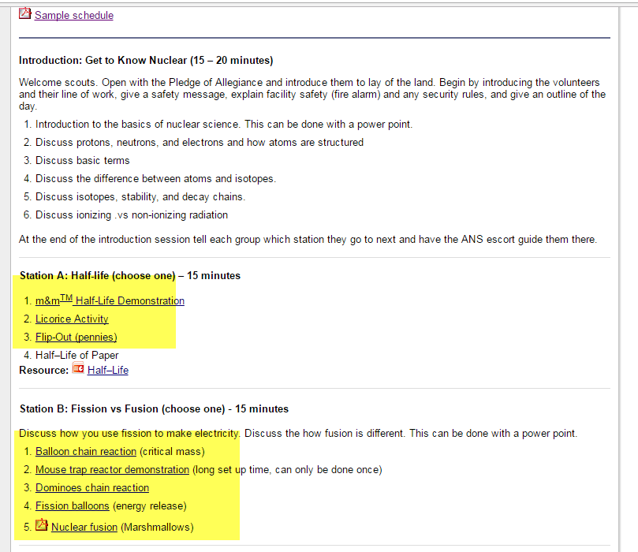
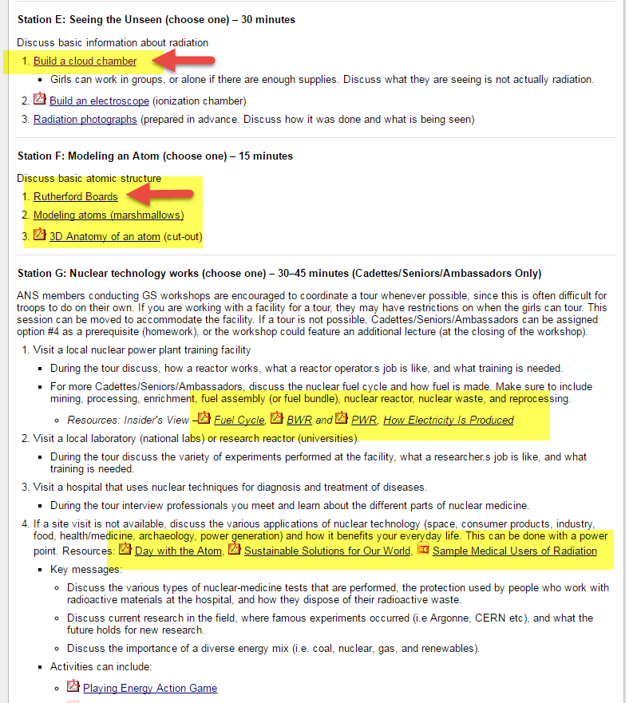
ans.org/pi/resources/girlscouts/

Slide 7
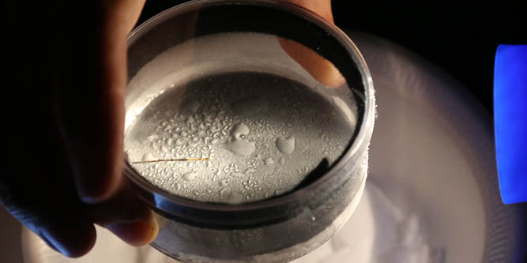

Boy Scout Requirements
Workshop Planning
Toolkit
ans.org/pi/resources/boyscouts/
Must meet all 8 requirements, however there are options for each requirement (Do ONE or Do TWO) which can help adjust your workshops to meet your needs.
See the BSA worksheet
http://usscouts.org/mb/worksheets/Nuclear-Science.pdf
Notes:
Do the following:
Tell what radiation is.
Describe the hazards of radiation to humans, the environment, and wildlife. Explain the difference between radiation exposure and contamination. In your explanation, discuss the nature and magnitude of radiation risks to humans from nuclear power, medical radiation (e.g., chest or dental X-ray), and background radiation including radon. Explain the ALARA principle and measures required by law to minimize these risks.
Describe the radiation hazard symbol and explain where it should be used. Tell why and how people must use radiation or radioactive materials carefully.
Compare the amount of radiation exposure of a nuclear power plant worker to that of someone receiving a chest and dental X-ray.
Do the following:
Tell the meaning of the following: atom, nucleus, proton, neutron, electron, quark, isotope; alpha particle, beta particle, gamma ray, X-ray; ionization, radioactivity, radioisotope, and stability
Choose an element from the periodic table. Construct 3-D models for the atoms of three isotopes of this element, showing neutrons, protons, and electrons. Use the three models to explain the difference between atomic number and mass number and the difference between the atom and nuclear and quark structures of isotopes.
Do ONE of the following; then discuss modern particle physics with your counselor:
Visit an accelerator (research lab) or university where people study the properties of the nucleus or nucleons.
Name three particle accelerators and describe several experiments that each accelerator performs.
Do TWO of the following; then discuss with your counselor the different kinds of radiation and how they can be used:
Build an electroscope. Show how it works. Place a radiation source inside and explain the effect it causes.
Make a cloud chamber. Show how it can be used to see the tracks caused by radiation. Explain what is happening.
Obtain a sample of irradiated and non-irradiated foods. Prepare the two foods and compare their taste and texture. Store the leftovers in separate containers and under the same conditions. For a period of 14 days, observe their rate of decomposition or spoilage, and describe the differences you see on days 5, 10, and 14.
Visit a place where radioisotopes are being used. Using a drawing, explain how and why they are used.
Do ONE of the following; then discuss with your counselor the principles of radiation safety:
Using a radiation survey meter and a radioactive source, show how the counts per minute change as the source gets closer to or farther from the radiation detector. Place three different materials between the source and the detector, then explain any differences in the measurements per minute. Explain how time, distance, and shielding can reduce an individual’s radiation dose.
Describe how radon is detected in homes. Discuss the steps taken for the long-term and short-term test methods, tell how to interpret the results, and explain when each type of test should be used. Explain the health concern related to radon gas and tell what steps can be taken to reduce radon in buildings.
Visit a place where X-rays are used. Draw a floor plan of this room. Show where the unit, the unit operator, and the patient would be when the X-ray unit is operated. Explain the precautions taken and the importance of those precautions.
Do ONE of the following; then discuss with your counselor how nuclear energy is used to produce electricity:
Make a drawing showing how nuclear fission happens, labeling all details. Draw another picture showing how a chain reaction could be started and how it could be stopped. Explain what is meant by a “critical mass.”
Build a model of a nuclear reactor. Show the fuel, control rods, shielding, moderator, and cooling material. Explain how a reactor could be used to change nuclear energy into electrical energy or make things radioactive.
Find out how many nuclear power plants exist in the United States. Locate the one nearest your home. Find out what percentage of electricity in the United States is generated by nuclear power plants, by coal, and by gas.
Give an example of each of the following in relation to how energy from an atom can be used: nuclear medicine, environmental applications, industrial applications, space exploration, and radiation therapy. For each example, explain the application and its significance to nuclear science.
Find out about three career opportunities in nuclear science that interest you. Pick one and find out the education, training, and experience required for this profession and discuss this with your counselor. Tell why this profession interests you.

Slide 8
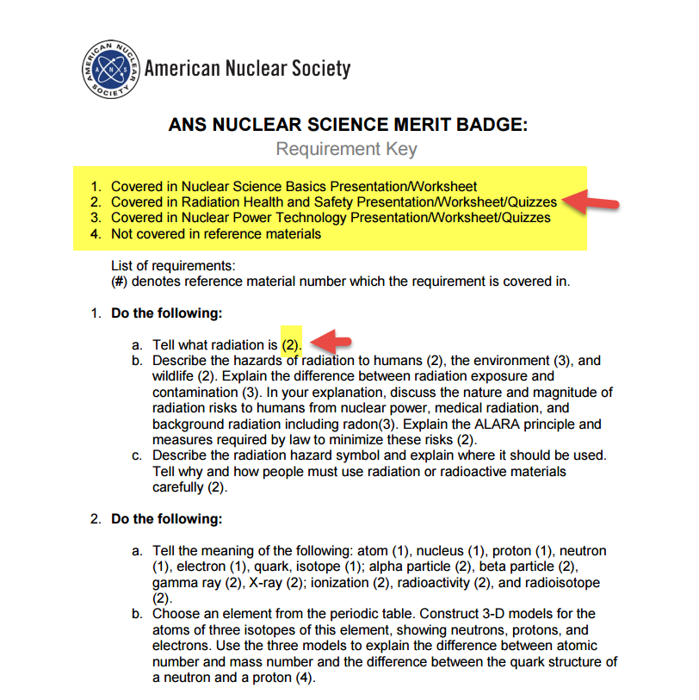
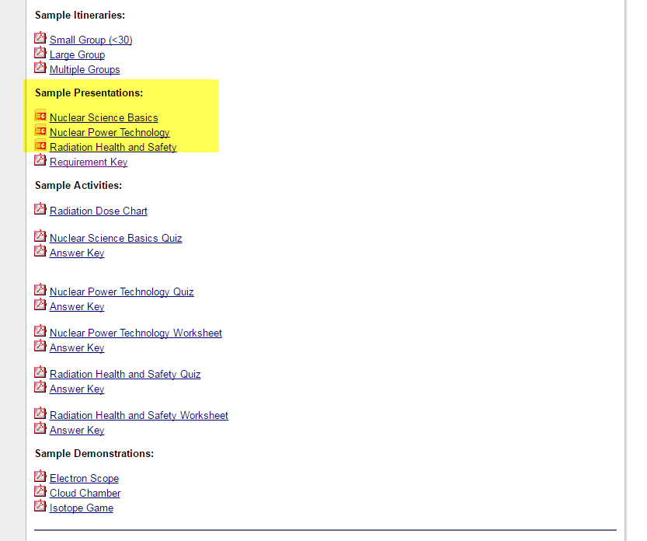
ans.org/pi/resources/boyscouts/

Slide 9
Project Planning
4-6 Months Out
2-12 weeks out
Establish a budget (average $45/per scout)
Secure funding if needed
Recruit 2-4 key volunteers
Reach out to local scout council to determine best dates
Build rapport with troops
Determine the best location
Determine registration cost ($5-15)
Recruit 3-6 additional volunteers to assist with registration and day of activities
Ensure volunteers know their roles and prepare for their presentations (samples are in the ANS toolkit)
Obtain supplies (ANS Store or PIA grant). GS patches must be purchased from ANS. BS badges are handled by their leaders.
Order lunch

Slide 10

Sample Hierarchy
Council- Pathway to Adventure
District- Nishnabec
Sponsoring Org.
Pack 341
Sponsoring Org.
Troop 318
Sponsoring Org.
Crew 348
District-Arrowhead
Contact Council Office
Visit a District Roundtable

Slide 11
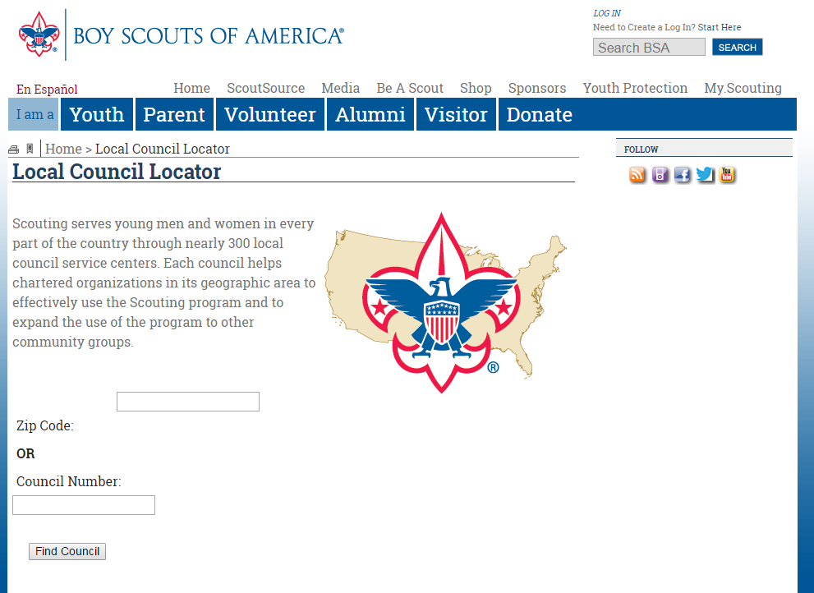
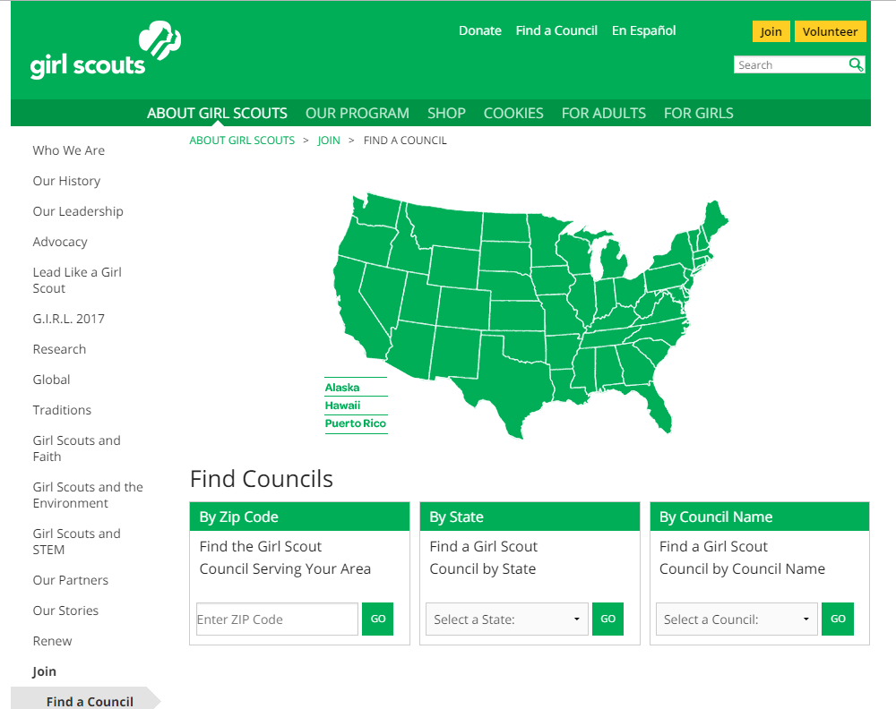
Find Your Council

Slide 12
Program Benefits
Direct:
  Introduces nuclear science to Scouts and attending adults.
  Encourages Scouts to pursue nuclear science in college/career.
  Nuclear related volunteer opportunity for members.
Indirect:
  Improves public perception of nuclear power industry.
  Brings nuclear awareness to university/local area.
  Can generate funds for local ANS section.

Slide 13
Best Practices
Do’s
Don’ts
Schedule break, include lunch
Limit your topic
Understand Your Audience
Have at least one member become a BSA counselor
Be Prepared
Keep it Simple, Make it Fun (KISMIF)
Go over time
Be Preachy (less talk, more action)
Be alone with any scout (2 deep leadership-Buddy System)
Notes:
In my experience, after contact with council, the GS-USA take care of all troop registration and advertising.
Girls behave better → Age limit not as high
Becoming a MB Counselor:
1.Adult Membership - good for one year and free
- Fill out adult membership form and submit to local COUNCIL
2.Apply to be a counselor - good for one year
- Fill out counselor form and submit to local COUNCIL
3.Youth protection training - good for two years
- Take online training at http://www.myscouting.org

Slide 14
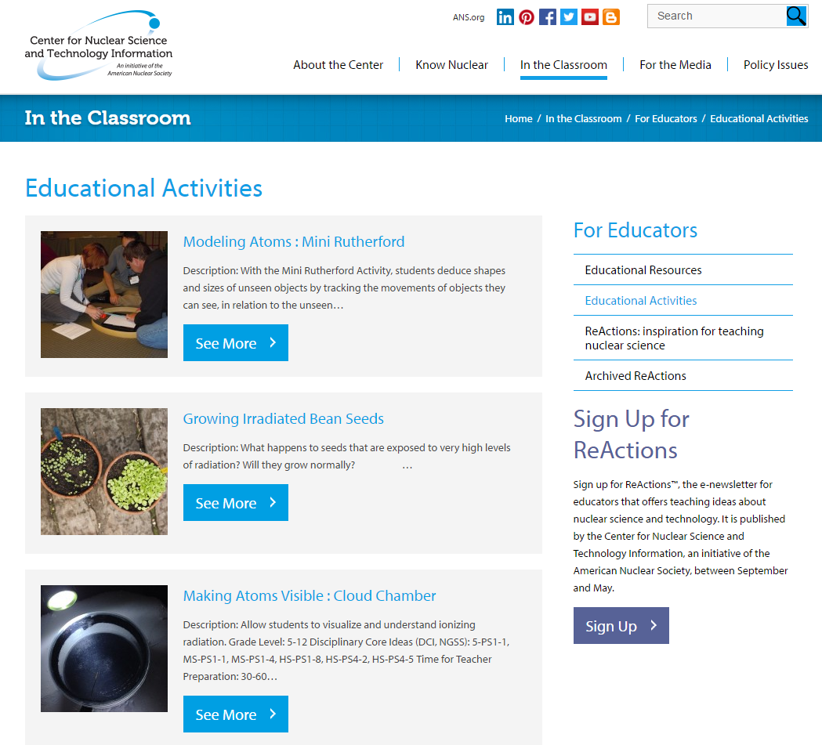
Additional Resources
nuclearconnect.org

Slide 15
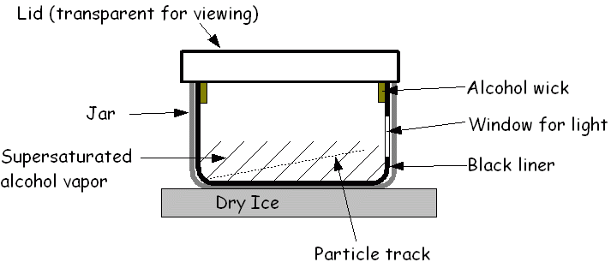
Making Atoms Visible : Cloud Chamber
Notes:
Making Atoms Visible : Cloud Chamber
Instructions can be found online: http://www.nuclearconnect.org/in-the-classroom/for-teachers/cloud_chamber
Live Demo video: https://www.youtube.com/watch?v=pewTySxfTQk

Slide 16
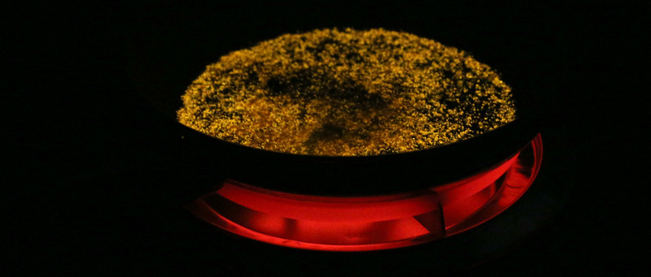
Irradiated Salt Demonstration
Notes:
Irradiated Salt Demonstration
Instructions can be found online - http://www.nuclearconnect.org/in-the-classroom/for-teachers/irradiated-salt-demonstration
Live demo video – Flynn Scientific https://www.youtube.com/watch?v=k3EWN4y3oTE

Slide 17
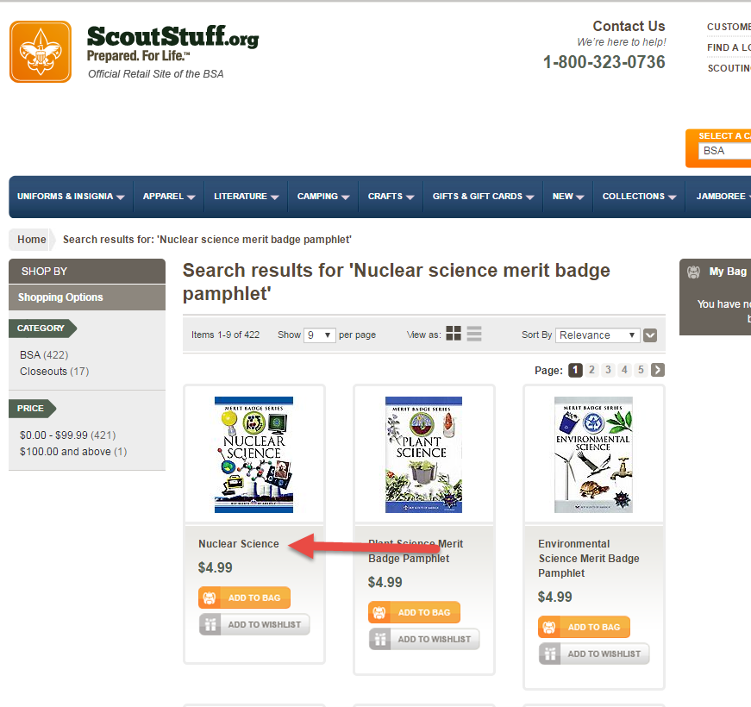
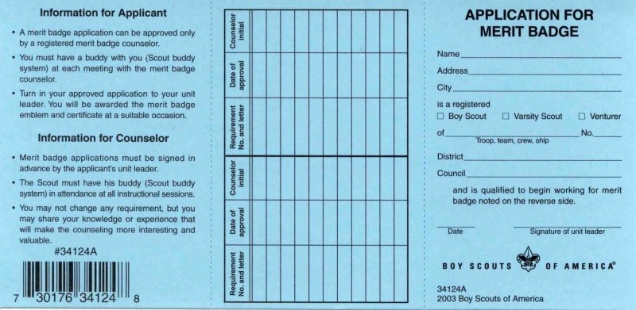
BSA Materials
Additional Resources
Can be purchased on Scoutstuff.org or your local scout store.
Nuclear Science Merit Badge Pamphlet
Blue Cards (scouts should bring their own, but it is good to have extra)
Nuclear Science Merit Badges (if you are a counselor, you can purchase them in advance and hand them out that day) Most troops prefer their advancement chair take care of it.
Notes:
Shipping from scoutstuff is high, recommend going to a store if you can.

Slide 18
Q & A

